Slide 1

Pattern-independent
Demosaicing;
Presented by Daniel Khashabi
Joint work with Sebastian Nowozin, Jeremy Jancsary, Andrew W. Fitzgibbon and Bruce Lindbloom

Slide 2
Outline
Demosaicing problem
Creating input-output pairs
Our demosaicing model
Experiments

Slide 3
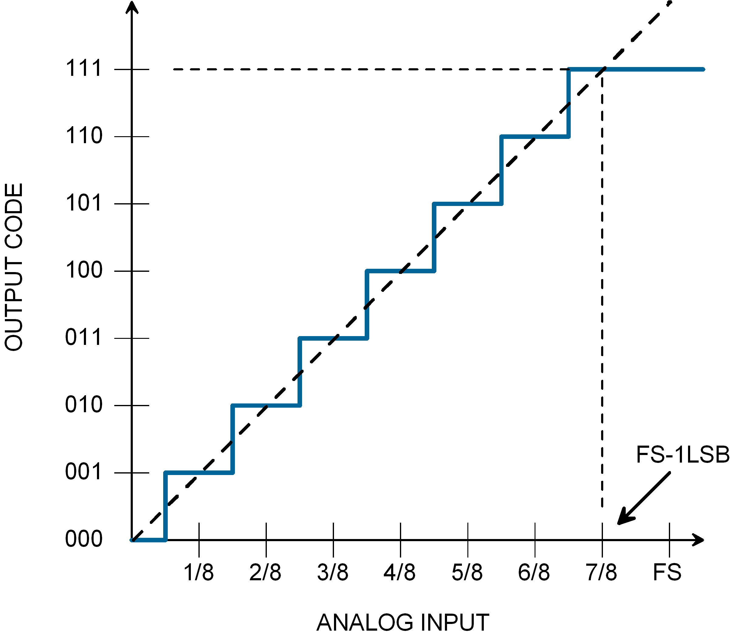
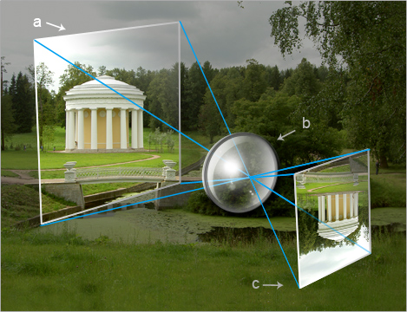
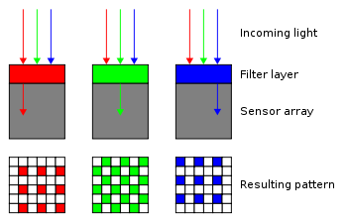
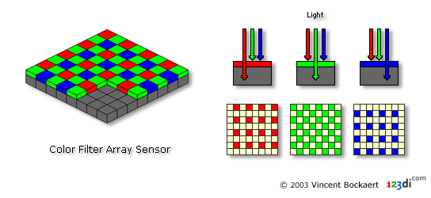

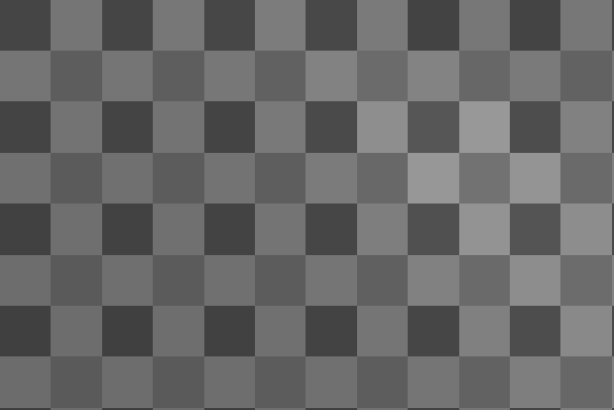
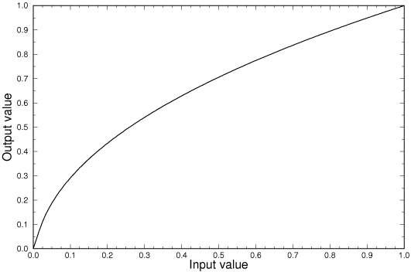
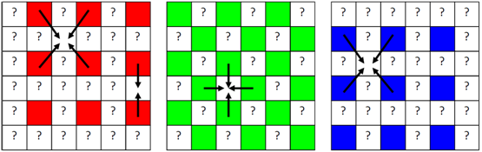
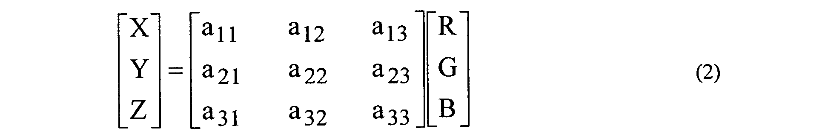
Raw Spcae
A simple camera pipeline
Scene
Optical operations
Color Filter Array (CFA)
Analog/Digital Conversion
Linear Transformations: black-level adjustment and color scaling
Mosaiced Linear Space
Camera output (sRGB)
Image correction: 3x3 color transform and Gamma correction (nonlinear)
Demosaicing
Demosaiced Linear Space
sRGB Space
Images from: http://pho.to/media/images/digital/digital-techlology.jpg

Slide 4
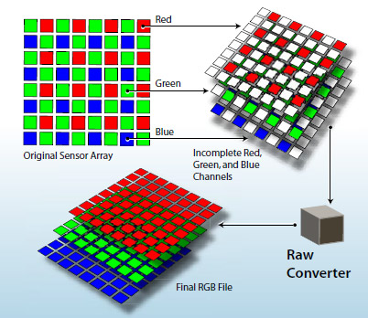
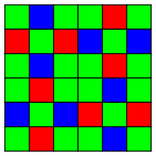
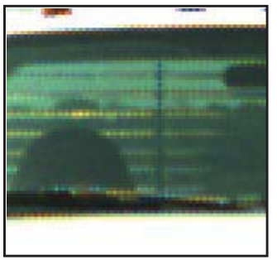
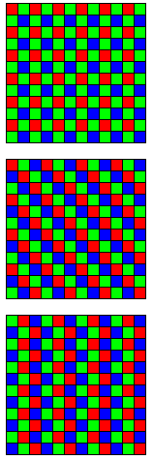
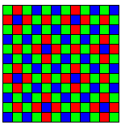
Raw Spcae
Demosaicing
Interpolating color-filter-array (CFA) samples to create full-resolution color images
Isn’t a solved problem?! NO!
The current methods are can be improved in terms of performance
Zippering effect still present in the output of many current method
The current methods are CFA-specific (mostly Bayer pattern) And not easily generalizable to new CFAs
All method are engineered for sRGB images
Demosaicing is lacking a good dataset
Many of low-level task could be done before/joint with demosaicing
Noise behaviour changes after demosaicing
Mosaiced Linear Space
Fuji X-trans
Demosaiced Linear Space
Bayer Pattern
sRGB Space
Image from: http://i.i.cbsi.com/cnwk.1d/i/tim/2012/02/06/Adobe-raw-demosaic-diagram.jpg

Slide 5
Raw Spcae
Overview of our approach
We design a supervised model.
For training the model we propose a procedure to create the ground truth dataset from light-space images
Our dataset is will be published with our work.
Our model is easily generalizable to different CFA patterns.
Our model can perform denoising jointly with demosaicing.
Mosaiced Linear Space
Demosaiced Linear Space
sRGB Space

Slide 6
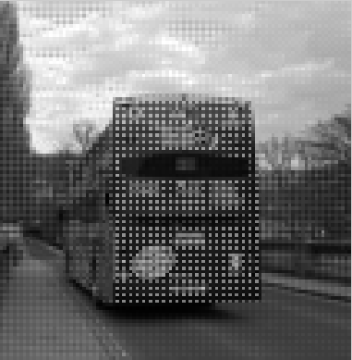
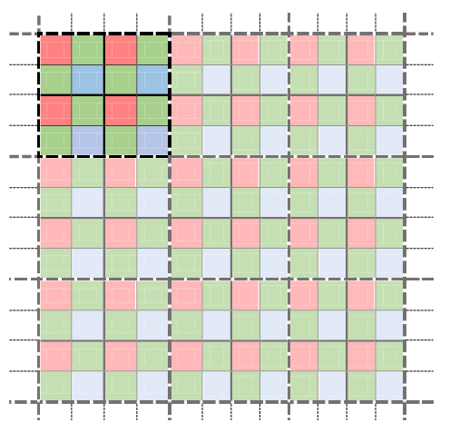
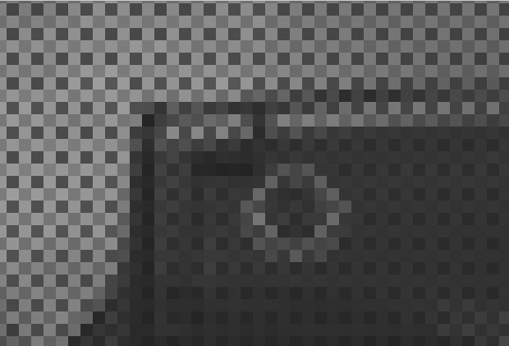
Raw Spcae
Creating ground-truth images
We want to design set of input-output pairs in linear light-space
We use the fact that images are scale-invariant
regardless of some properties like noise distribution
Mosaiced Linear Space
Ground truth input image
Virtual sensor
Demosaiced Linear Space
Ground truth output image
sRGB Space

Slide 7


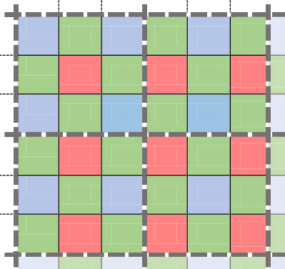

down-scaling strategies
There is a systematic bias between red and blue, when the size of the square is even
When the size of the block is odd, this systematic bias vanishes, but the ratio of color sensors are different
This ratio goes to one, when the size of the block increases
We devised a strategy to compensate for the systematic bias when the size of the window is even

Slide 8
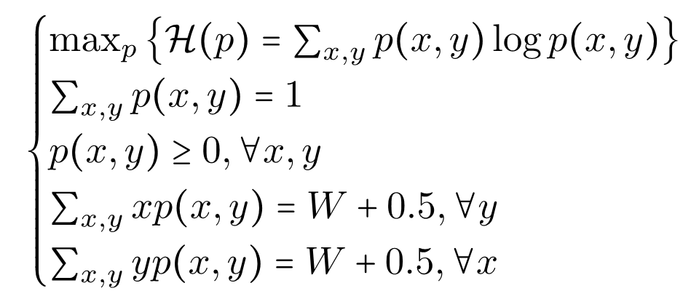
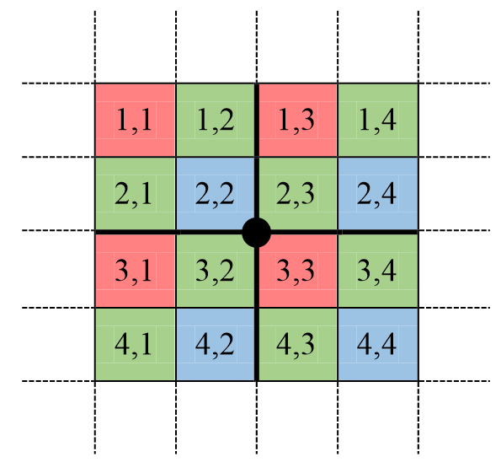
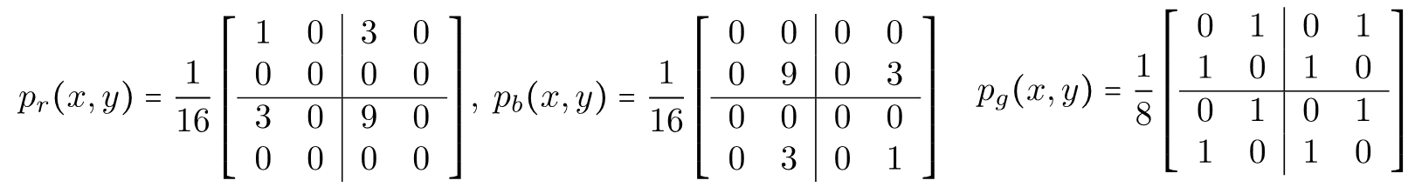

Max-Ent down-scaling
Goal:
Want to bring the center of the mass, for each color, to the center of each block
Uniform
MaxEnt

Slide 9
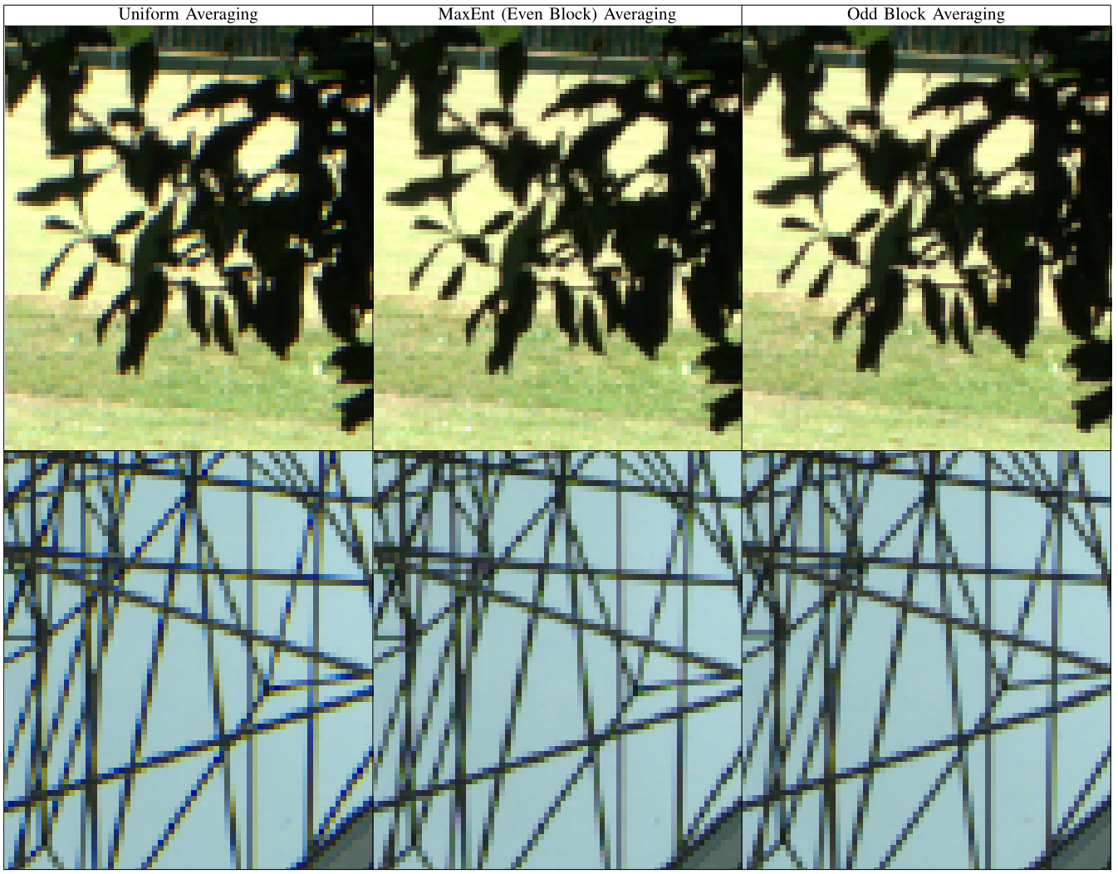
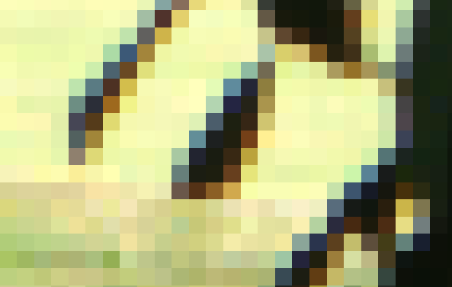
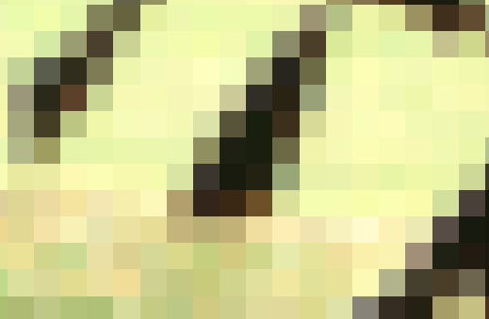
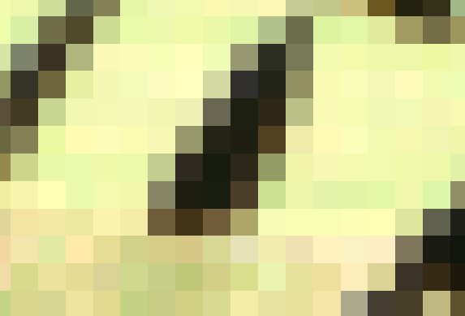
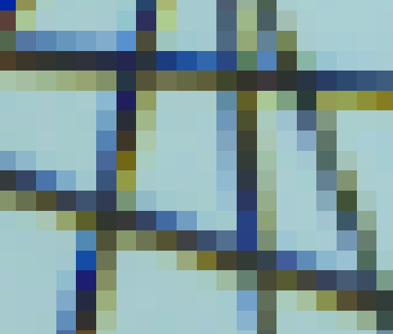
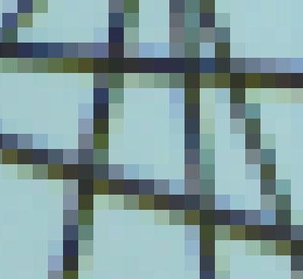
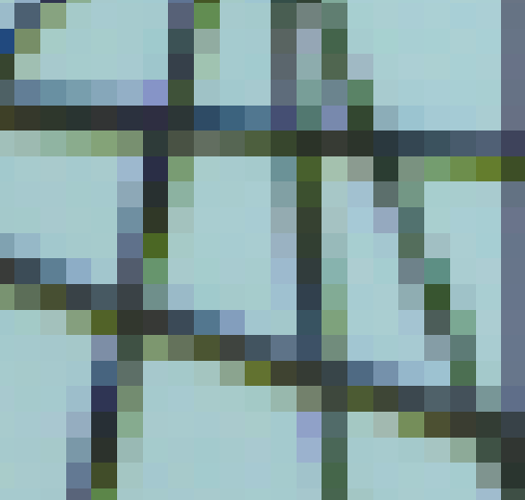
Down-scaling, a real example

Slide 10
Creating ground-truth images
Collected 500 raw images captured by Panasonic-Lumix LX-3
We need to be able to go along a good camera pipeline
We use dcraw to transfer images to different stages in camera pipeline
We write out the specifications of each step, for each image
Then simulate our own pipeline in MATLAB, with demosaicing replaced with our own down-scaling
Raw images
Linear Transformations: black-level adjustment and color scaling
Demosaicing
Image correction: 3x3 color transform and Gamma correction (nonlinear)
Camera output (sRGB)
Ground truth output image
Raw images
Linear Transformations: black-level adjustment and color scaling
Down-scaling
Image correction: 3x3 color transform and Gamma correction (nonlinear)
Camera output (sRGB)

Slide 11
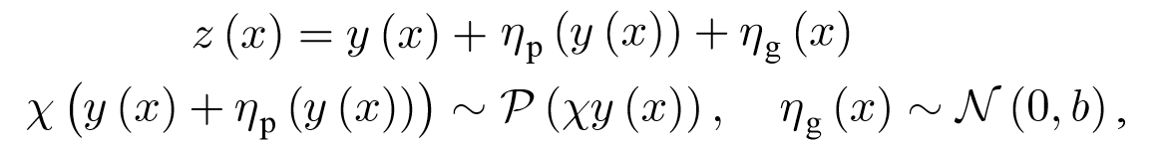
The noise behaviour in down-scaled images
Averaging decreases the noise present in images.
Need to devise a way to bring back the noise into our images
Since the goal is to perform demosaicing on the original raw images
We use a recent method of noise estimation for raw images [1]
Models as Poisson-Gaussian distribution
We then add back the noise into images
Raw images
Linear Transformations: black-level adjustment and color scaling
Noise estimation
Down-scaling
Noise addition
Image correction: 3x3 color transform and Gamma correction (nonlinear)
Camera output (sRGB)
[1] Foi, Alessandro, et al. "Practical Poissonian-Gaussian noise modeling and fitting for single-image raw-data." Image Processing, IEEE Transactions on 17.10 (2008): 1737-1754.

Slide 12
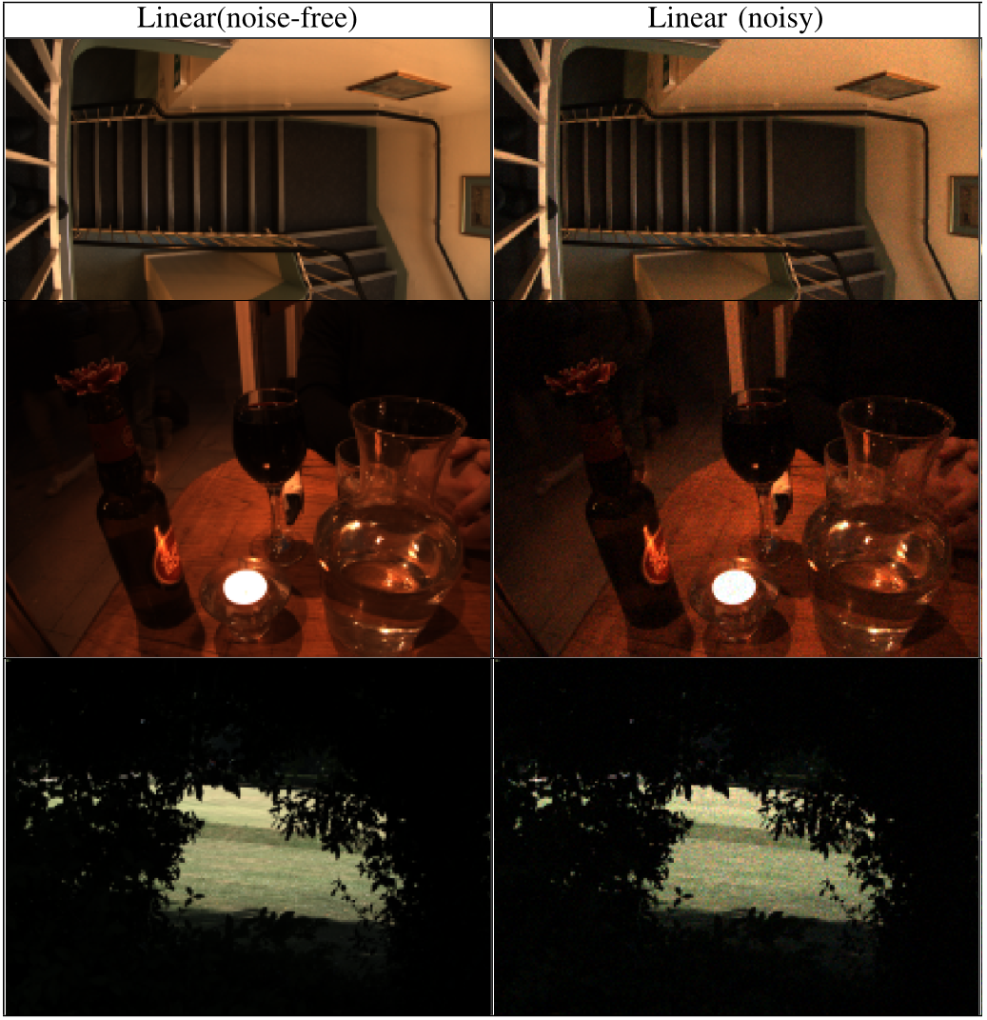
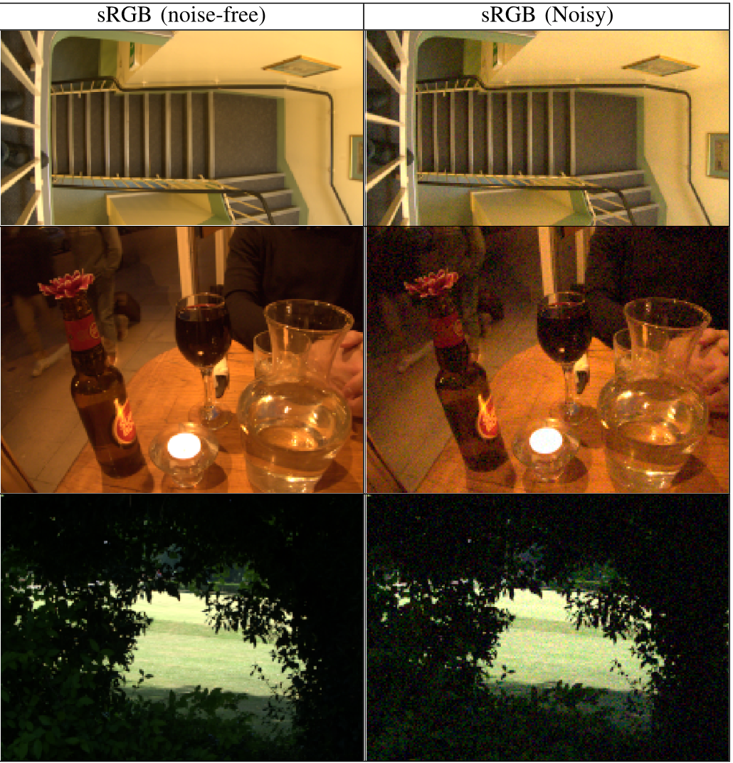
Samples of noise-addition to image

Slide 13
Raw Spcae
Possible tasks
We have developed these images
Among the above tasks we are mostly interested in doing the followings:
Demosaicing in linear light-space
Deniosing +demosaicing in linear light-spcae
Noise-free-linear
Noise-free-sRGB
Mosaiced Linear Space
Raw images
Noisy-linear
Noisy-sRGB
Demosaiced Linear Space
sRGB Space

Slide 14
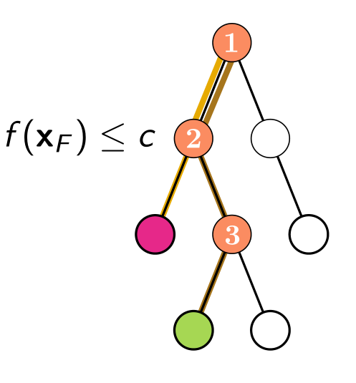
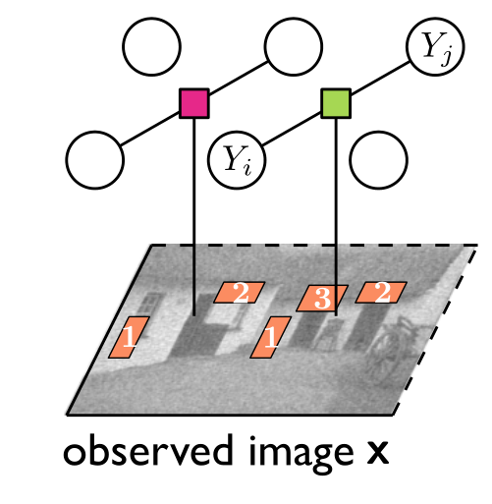
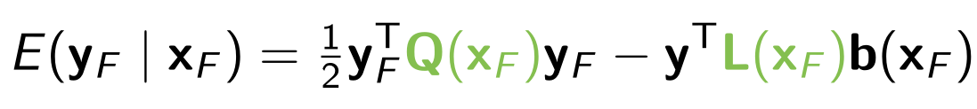
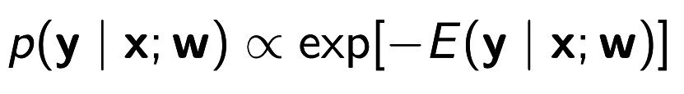

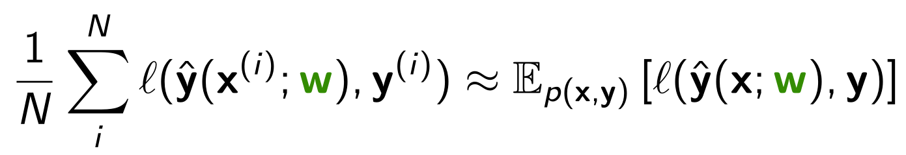
Regression tree field
Combines regression tress (Non-parametric) and Gaussian Random Fields
Energy defined for each factor:
Measure of the goodness of particular labelling given inputs, and parameters of the factor
Coefficients of are determined by the regression tree, or each leave stores set of parameters.
Inference:
Training: Jointly choosing the structure of the tree, and parameters of at leaves such that minimizes the empirical risk, in greedy way:

Slide 15
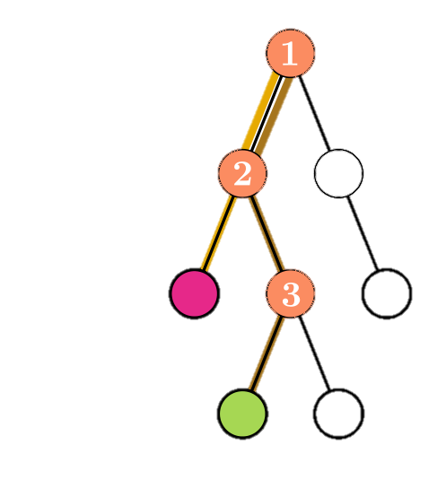
Regression tree fields, for demosaicing
Tree Feature checks,
A preliminary bilinear interpolation
RFS filters [1] which act like derivatives in different directions, with various scales
Quadratic energy basis vectors,
Set of neightbouring pixels,
RFS filter responses
[1] RFS filters: http://www.robots.ox.ac.uk/~vgg/research/texclass/filters.html

Slide 16
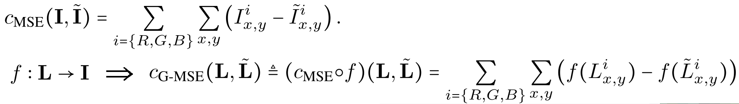
Regression tree fields, for demosaicing
Raw Spcae
The generalized loss function,
An approximate camera pipeline, from linear-space, to sRGB space, which is differentiable
An analytic approximation for gamma transform
An approximate 3x3 color transform,
Stacking RTFs,
Mosaiced Linear Space
2
2
Demosaiced Linear Space
sRGB Space
Mosaiced image
RTF1
RTF2
[1] RFS filters: http://www.robots.ox.ac.uk/~vgg/research/texclass/filters.html

Slide 17
Experiments(1)
Demosaicing, in linear-space, without noise:

Slide 18
Experiments(2)
Demosaicing, in linear-space, without noise:

Slide 19
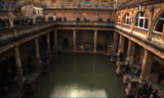
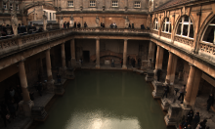
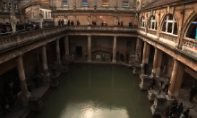

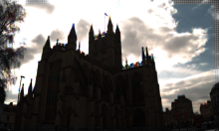
Some samples
Ground truth Bilinear CS RTF
NAT: Non-Local Adaptive Thresholding:
NLM: Non-Local Means

Slide 20
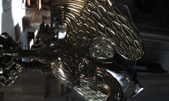
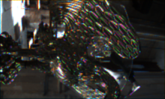
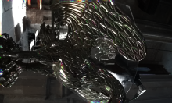
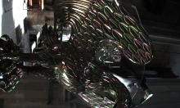
Some samples
Ground truth Bilinear CS RTF
NAT: Non-Local Adaptive Thresholding:
NLM: Non-Local Means

Slide 21


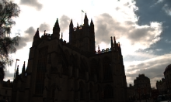
Image Margins
Not a considerable margin in RTF outputs
NAT NLM OneStepAP RTF
NAT: Non-Local Adaptive Thresholding:
NLM: Non-Local Means

Slide 22
And more to go ….
RTF with the generalized loss function
Full denoising-demosiacing experiments
Other CFA patterns: Fuji-Xtrans pattern
Further work?!

